Slide 1
BI Analysis Week 9
Shawna Tuli (Shawna.tuli@avanade.com)

Slide 2
Agenda
Final Presentation

Slide 3
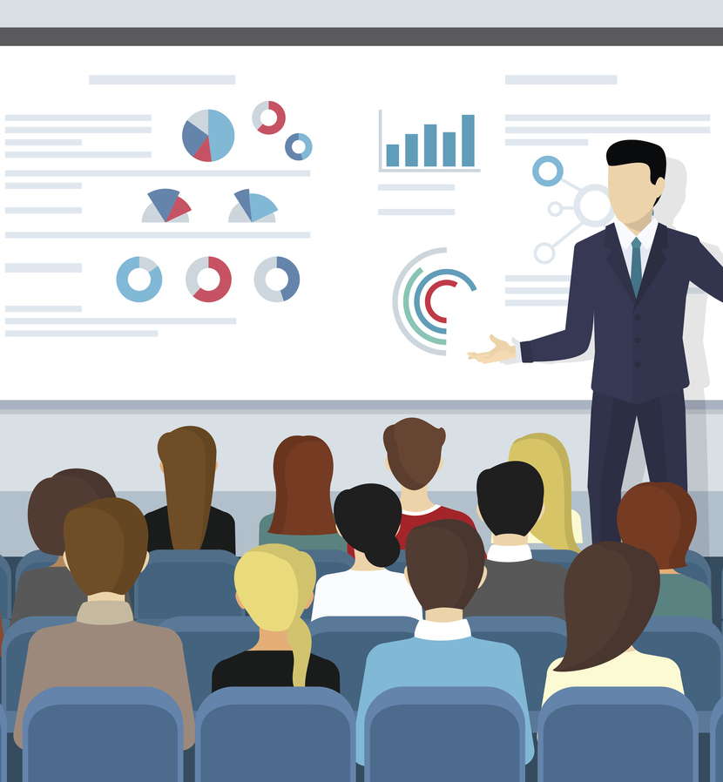
Final Presentation
Notes:
https://www.cbs.de/en/blog/15-effective-presentation-tips-to-improve-presentation-skills/

Slide 4
Presenting successfully: 16 tips to improve your presentation skills and give a killer presentation
Why presentation skills are important
Presentation skills are crucial in today's professional landscape, enhancing one's ability to communicate effectively and persuasively. They not only help in delivering messages clearly but also boost confidence and engagement with the audience. Mastering presentation skills can lead to career advancements, improved professional relationships, and increased influence.

Slide 5
Benefits of improving presentation skills
Enhanced communication: clearer and more impactful message delivery.
Increased confidence: greater self-assurance during public speaking.
Career advancement: better job prospects and professional growth.
Stronger engagement: improved ability to captivate and maintain audience interest.
Influence and persuasion: more effective in convincing and motivating others.

Slide 6
How to give a good presentation? This is how to succeed!
In order to be able to present successfully, not only the layout and the content of the presentation must be convincing. The decisive step is to convey the content of the presentation to the audience in the best possible way by presenting it correctly. The tips listed below should help you do this by improving your presentation skills. The most important thing to keep in mind is a healthy combination of the tips listed below. (The order of the tips does not give any information about their importance).

Slide 7
Not every tip will lead to a successful presentation. What is important in a presentation?
As mentioned earlier, you should try to implement a combination of the tips to give a successful presentation. It should be noted that not every one of these tips needs to fit in your own presentation. In addition, too many of these tips can make the presentation look overloaded and too "rehearsed". Therefore, think carefully in advance about what you want to pay particular attention to.

Slide 8
Tip 1: Maintain eye contact while presenting and smile
In order to give each of your listeners the feeling of being important and to make them feel personally addressed, it is particularly important to maintain eye contact with the audience during the presentation. Not only does this exude confidence, but it also helps your audience to connect with you and your subject. It also helps you feel less nervous. Easier said than done right? Here's what can help:
Find someone in the audience who seems to be genuinely interested in the topic and is listening attentively (for example, your lecturer). Make eye contact with this person at the beginning of the presentation. Once you start feeling more calm and confident let your gaze drift over the audience to address the other listeners as well. Keep returning your gaze to the initial person to stay calm throughout the whole presentation.
Another alternative is to find a fixed point in the room (preferably on the wall behind the audience) which you fix at the beginning of the presentation. Similar to the first example, after you have achieved confidence, you can let your gaze wander over the audience and return to the previously selected fixed point again and again.
Don't look at the screen! Don't look at the floor! Don't just look at your index cards! Don't just look at the laptop!

Slide 9
Tip 2: Use of gestures and facial expressions
To emphasize the content of your presentation, it is advisable to use appropriate gestures and body language to get your message across. Avoid crossed arms, hands behind your back, or in your pockets during a presentation. Always stand up straight, and try not to appear tense or stressed. You can do that by using your hands and arms to emphasize what you are saying and get your message across. Your facial expressions should always be friendly and open. Smile and show that you enjoy the topic and you are confident in the information you are presenting.

Slide 10
Tip 3: Avoid distractions
Often you will not be able to avoid the use of aids. For example, you may need to use a laser pointer to show something on the screen, or you may need to use a pen to write something down on a flipchart. To avoid distractions for you and the audience, get into the habit of putting down tools you don't need! That way you will not be tempted to deal with them in the first place. You will also have your hands free for gestures.

Slide 11
Tip 4: Be prepared: Practice makes perfect
Practice makes perfect, right? If you prepare well before the presentation, you will feel more relaxed and confident while presenting and it will also improve your body language.
Here are some ways to help you prepare for a presentation:
Rehearse in front of a crowd
Take notes
Experiment
Time yourself
Record yourself

Slide 12
Tip 5: Be confident
By appearing self-confident, you convey to the listener that you are confident in your topic and have prepared yourself sufficiently. Try to relax and not appear too stressed or nervous. Another tip for advanced speakers: Step out in front of the podium and walk around the room and get closer to the audience. This also exudes self-confidence and helps in attracting your audience's attention.

Slide 13
Tip 6: Effective beginning/end
Good presentation skills can help you in captivating your audience straight away. In order to do that, you should start your presentation with a bang. Many studies show that if you can capture someone’s interest straight away, there’s a good chance they’ll listen to the rest of the presentation. Shock the audience, ask them to imagine something or think of a what-if situation, share a personal story, share a joke, use a quote, or a video. You should also give an overview of the time and structure of your presentation. This outline should run through your presentation so that you can always assign the individual contents to an outline point. It is also helpful for your audience to have the outline displayed in a slimmed-down form during the whole presentation.
How you end the presentation is as important as how you start it. A weak ending will leave the audience uninspired. But a good ending will motivate them and help them walk away on a positive note. For example, include a call to action, end the presentation with a memorable quote, or a personal story, and don't forget to thank and acknowledge the audience.

Slide 14
Tip 7: Speak freely
The headline speaks for itself. To make the presentation as lively and enjoyable as possible, you should avoid reading it off. Speak freely, slowly, and clearly. If you are not yet confident in what you are presenting, try using note cards. But keep in mind: No continuous text, but only short, concise bullet points! If you use note cards to support you, it is especially advisable at this point to memorize at least the beginning and end of your presentation, as eye contact is crucial at these points.

Slide 15
Tip 8: Avoid filler words
In order to make your presentation flow as smoothly and confidently as possible, you should avoid using filler words such as "um," "so," and so on. For your listeners, these words convey insecurity and inadequate preparation.

Slide 16
Tip 9: Bring along something to share
In addition to a handout, other small takeaways can also significantly improve your presentation. For example, if you are giving a presentation on gummy bears, why not offer some to your audience? If you are giving a presentation about your fishing hobby, why not show the audience your fishing equipment?

Slide 17
Tip 10: Use different types of media
A presentation can quickly become boring and monotonous. To avoid this, it is advisable to use different types of media. For example, combine videos and flipcharts, use the whiteboard, or show something practical on a model. This will increase the attention of your audience enormously and will help in keeping them engaged until the end.

Slide 18
Tip 11: Use effective pauses
When giving a presentation, you should keep in mind that you have already heard the content several times - your audience probably hasn't! Therefore, give your audience enough time to read and understand the content of your slides.
Effective use of speech pauses is a master technique. It is one of the most versatile tools in a presenter's toolbox. Yet very few people perform it well. A pause, if used correctly, can add a great deal to your presentation or speech. Pause before, during, or after saying something that you would like to emphasize. Pausing between two different parts of your presentation can indicate to the audience that something new is coming. A quick pause could also help you in remembering your next point, without the audience noticing that you forgot what to say.

Slide 19
Tip 12: Speak the language of the audience
When creating your presentation, you should already think about your target audience. This will help you present successfully later on. It is especially important that you speak the language of the audience. Use appropriate and relevant examples. Use "strong" and meaningful words in short sentences to avoid losing the audience. Make sure to use appropriate analogies and anecdotes and avoid foreign words, empty phrases, and clichés. If you have to use foreign words, explain them in a handout or footnote within the presentation.

Slide 20
Tip 13: Engage with the audience
Always try to keep the attention of your audience and keep them engaged during a presentation. To do this, it is advisable to regularly involve the audience. One way to do this is to ask questions. Deliberately ask "easy" questions so that can easily be answered by your audience.
Another way to involve the audience in your presentation is by interacting with them. To make a point clearer, you can use an example to explain it in more detail, using a person (whose name you should know). You can address participants directly and refer to their work.

Slide 21
Tip 14: Don’t fight the stage fright & take deep breaths
Stage fright is one of the biggest enemies of a presentation, yet you shouldn't let yourself be a victim of your feat. Do not fight it, rather address your fear and try and accept it, and transform it into positive enthusiasm. Don't let your stage fright get you all worked up and nervous. Take a couple of deep breaths to get oxygen to your brain and relax your body.

Slide 22
Tip 15: Choose the right angle on standing during a presentation
One of the most frequent questions that speakers ask themselves during a presentation is, how do I best position myself, and where do I stand in front of the audience?
You have a free stage without a podium
In many cases, you will be facing your audience in a "free space", without a podium. This gives you a lot of room to move, but at the same time, it creates uncertainty because you don't know how to position yourself properly or how to move. Avoid standing frontally in front of the audience! This frontal facing is unconsciously perceived negatively by the audience. It is perceived by the audience as a kind of frontal attack and causes stress in your audience. Make sure to stand slightly to the side of the audience. If you notice during the presentation that you are again standing frontally in front of your audience, simply move your right or left foot 20 cm forward.
You have a podium at your disposal
A podium makes it easier to decide how to position yourself and where to stand in front of the audience. In order not to make your presentation too monotonous, it is advisable to leave the "safe position" behind the lectern from time to time, e.g. to walk to the other side of the screen or to show something on the flipchart. This brings movement into your presentation and helps keep the connection with your audience.

Slide 23
Tip 16: Create something with the whiteboard during the lecture
PowerPoint is no longer the tool of choice for a successful presentation. Photo collages, company logos on every slide and flashing text boxes often distract from the essentials. A presentation convinces the audience especially when they witness how something is being created. In addition to the classic flipchart, the whiteboard is recommended for this purpose. This is because diagrams, keywords and the results of a brainstorming session are written in real time on a whiteboard. Board markers allow a wide range of colors and the magnetic property of pinning additional information. The result of the presentation produced in this way is remembered longer than ready-made slides.

Slide 24
Timeline

Slide 25
Program
Kick-Off
Students will meet their teams and begin planning their project.
4 Workshops
Students will attend guided workshops covering key tools used in data science projects.
Help Sessions
Data@UCI will provide mini help sessions following the end each workshop.
Final Presentations
Groups will have the opportunity to present their projects and win prizes.

Slide 26
Week | Timeline
Week 1 (1/6-1/12) | Regular Event: Info Session for Mentees
Week 2 (1/13 - 1/19) | Regular Event : Project Kick-Off
Week 3 (1/20 - 1/26) | Thursday - Workshop 1: Tour of Notebooks/Environments/IDEs + Help Session
Week 4 (1/27-2/2) | Thursday - Workshop 2: Data Exploration (Pandas & Feature Selection) + Help Session
Week 5 (2/3 - 2/9) | Thursday - Workshop 3: Machine Learning (Scikit-Learn & Model Evaluation) + Help Session
Week 6 (2/10 - 2/16) | Thursday - Collaboration with Design@UCI (tentative + midterms)
Week 7 (2/17 - 2/21) | Thursday - Workshop 4: Data Visualization (Power BI or similar) + Help Session
Week 8 (2/24 - 3/1) | Thursday - Final Winter Project Help Session
Week 9 (3/3 - 3/9) | Thursday - Final Presentations

Slide 27
Deliverables

Slide 28
Week | Deliverable
Week 1 (1/6-1/12) | Commitment
Week 2 (1/13 - 1/19) | Meeting Series
Week 3 (1/20 - 1/26) | Jupyter Notebooks
Week 4 (1/27-2/2) | Exploratory Data Analyses
Week 5 (2/3 - 2/9) | Machine Learning
Week 6 (2/10 - 2/16) | Design
Week 7 (2/17 - 2/21) | Data Visualization
Week 8 (2/24 - 3/1) | Presentation
Week 9 (3/3 - 3/9) | Final Presentation

Slide 29
Thank you!

